Slide 1



Slide 2

Class Names & Teachers
Beverley | Mole | Eden
Mr Booth | Miss Elharrati | Miss Adkins
Class support – Mrs Veena, Mrs Heidar, Mrs Hudson

Slide 3
Reading top tips!
Many young children struggle with reading because they are introduced to books which are too hard for them. Every child develops at their own speed so try to be patient.
How to switch them on!
● Encouraging your child to choose a book they want to read – books with pictures are often the best to help them gain confidence.
● Asking your child’s teacher about the types and level of book that will best suit their level of reading.
● Reading harder books to them if they want to hear more complex stories, but letting them read the easy bits.
● Reading their favourite book again and again with them. Repetition helps your son or daughter learn new words.
TB

Slide 4

Second hand books on Vinted, World of Books.

Slide 5

Reading
5- 10 minutes of reading each day – 5 – 6 times each week
Children on the Jolly Phonics scheme will continue to work through these books. Jolly phonics front page of book to visit each time your hear your child read
6 acknowledgements written by the adult per week
Children receive a sticker reward for completing 6 reads.
Reading Records checked every Monday by teacher.
Once all JP books have been read, the children will move onto the TreeTops scheme

Slide 6
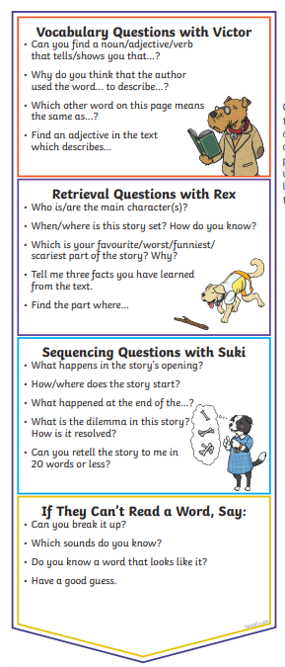
What Your Child’s reading record should look like
Date | Signed | Comments | Book
18.9.26 | Mum | Super reading | Beach adventure p4
19.9.26 | Dad | Terry found the following words tricky today – table, sun, ice cream. | p7
20.9.2 | Grandpa | Terry explained that the story took place at the beach and towards the end, was set in Amy’s house. | p10

Slide 7
BIG Books
10 Carefully chosen books for the children to read by themselves and/ with an adult, throughout the year
Children receive a stamp for each book read. A High 5 and Top 10 certificate.
Book Review – must be completed before they
choose a new book

Slide 8










Big Books

Slide 9
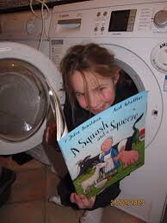
Reading Rocks! – photo
Who can find the funniest place to
read in your class?
Please take a picture of your child reading
somewhere fun for a whole class display.

Slide 10
https://www.westbourne.sutton.sch.uk/
The following information can be found on the Year 2 class page:
Curriculum Overview
Learn Its
Spell Its
Big Books
Reading and phonics links
Slides from todays meeting

Slide 11

Homework
If a child’s spellings aren’t learnt each week, this could mean that a child may not be able to spell over 360 words in one year!
Spellings each week – handed out Friday. Quizzed the following Friday.
Spell Its – words they’re expected to know by the end of year 2. Built into the spelling list
Their spelling quiz will go home with them on a Friday

Slide 12

Green spelling book – complete practise pages in book
                Look Say Cover Write Check
Week 1
Homophones and Near Homophones
there
their
they’re
here
hear
see
sea
to
too
two
Dictation later in the year + sticker for showing home learning

Slide 13
Maths
L
Year Two:
X2, x3, x4 x5, x9, x10,
By the end of Year 2 children are expected to be secure with these times tables and related division facts.
Hit The Button - https://www.topmarks.co.uk/maths-games/hit-the-button
timestable.co.uk

Slide 14
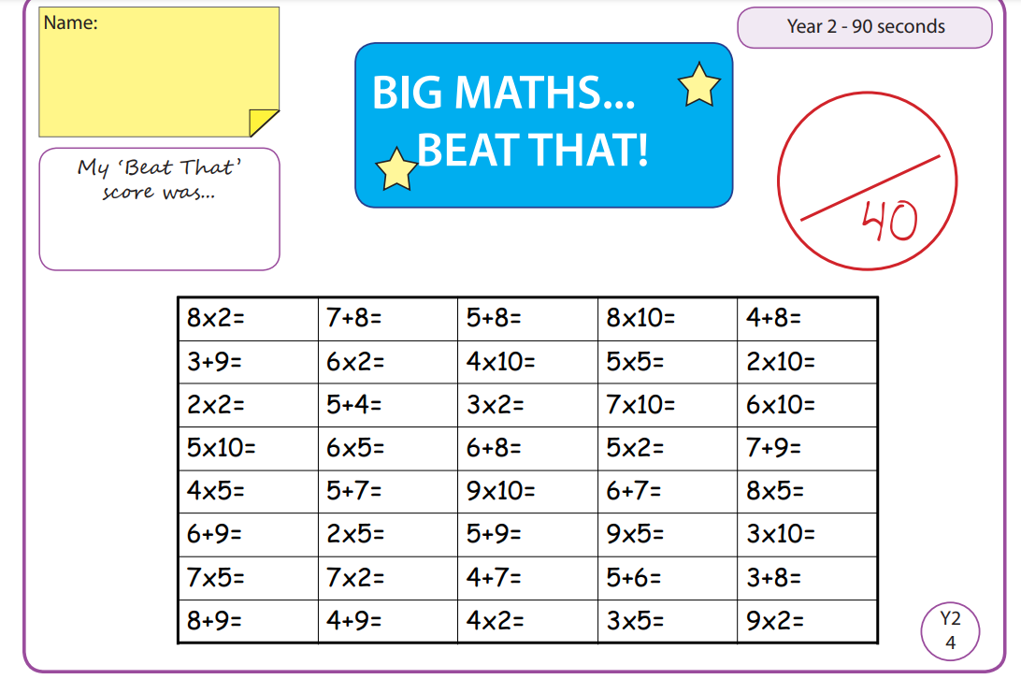
L
Big Maths/Written Arithmetic – quiz every Friday.
Children will bring home their Big Maths and Written Arithmetic sheets on a Friday.
You can assist your child by going through the questions they may not be getting right.

Slide 15
Equipment
H
Book Bags only, please. Best for school as no room for rucksacks on pegs
Fruit – BYO or enjoy fruit provided by the school
Water Bottle – only water
PE kits – Named – Joggers during winter months, trainers. Shoulder length hair must be tied back. No jewellery except stud earings – these must be covered with tape for PE
Pencil cases not required for Year 2
Please name all of your child’s clothing.
Toys allowed – pocket size only.

Slide 16
Reminders
Please ensure you provide a BIG wave when you see your child at the end of the day.
Inform the office if someone different is picking them up
School opens at 8:35.
Packed lunches - healthy lunch (guidance), no nuts
Clubs - a timetable has been sent on ParentMail. If your child can’t make a club, please inform the office
Coats on rainy and cold days
Shoe laces - if your child has laces, please teach them how to tie them
If you need to speak to a teacher, please arrange a meeting via the school office. If you would like to take the matter further, please arrange a meeting with Mr Booth (Phase Leader).

Slide 17

Trips:
Autumn Term
Painshill Park (Beverley and Mole)
Geography fieldtrip
Spring Term
St Paul’s Cathedral
Summer Term
Library visit

Slide 18

Dates
TB
Parents Evening – Wednesday 21st and Thursday 22nd October
Aututmn Half term: w/c Monday 27th October
End of term: Thursday 18th December at 1:55pm
Return to school: Tuesday 5th January 2027
Class assemblies
Beverley Class Assembly: Wednesday 20th January
Eden Class Assembly: Thursday 21st January
Mole Class Assembly: Wednesday 27th January

Slide 19



